Slide 1


500 Queens VC
100 New Female Founder Startups in Queensland, Australia 2021
Find Out More Here, Then Become A Founder.
Presented By:
Luke Catalyst Nathan Hayes
https://youtube.com/playlist?list=PL9jLSm_Ni6aH-mKHflIbnavMhTPDByV7e
Disclaimer: All 100+ Start-ups will have female CEOs, plus have majority female executive. All other genders are welcome.

Slide 2




Introduction
There are infinite futures awaiting female will power to bring them into our common reality. If you truly desire gender equality, then you must be willing to create the future through visionary long term civilisation planning.

Slide 3



Brisbane City,
Queensland.
1: World Leading Ecosystems
2: Worlds Biggest Moonshots
3: Worlds Most Trustworthy A.I.
4: Worlds Biggest Box Office Hits
5: Worlds 1st Autonomously Built City

Slide 4


World Leading Ecosystems
Start-up Fluently, Sustain the Momentum, Flow-on Cascade and Next Generations.

Slide 5

Worlds Biggest Moonshots
Dream BIG. Grow Them BIGGER.
Scale Up 1st Principals Thinking.

Slide 6

Worlds Most Trustworthy AI
Aura of Intelligence in a Global Association for Joyful Responsible Abundance on Earth. #AuraOfIntelligence #GAJRAearth

Slide 7
Worlds Biggest Box Office Hit
"When a wave of Galactic Climate Change creates turbulent celestial energies of incredible force, it is up to the people of Earth to unite and devise a plan to save over 1,000 planetary civilizations including Earth."
Galactic Climate Change and The Dark Energy Wave Will Now Face Humanity. #aTimelessLand #CrystalCitiesOfOz

Slide 8
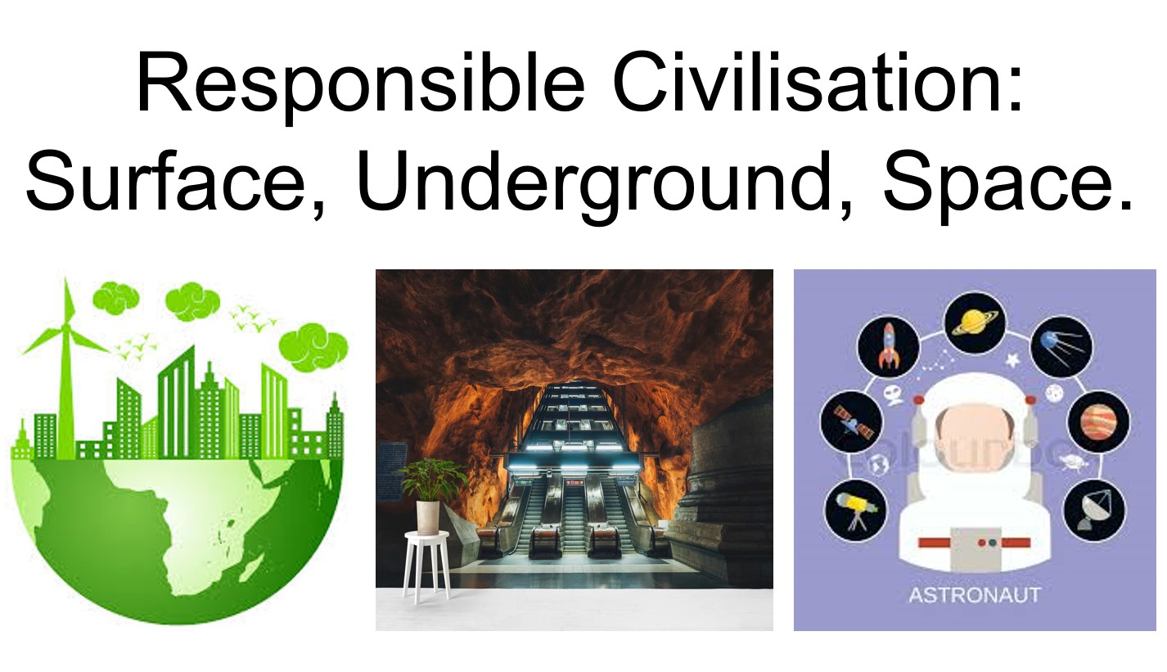
Worlds 1st Autonomously Built City
A Crystal City Underneath Moreton Bay Marine Park A.K.A. Quandamooka Country. #10MillionPeople #SafeFromExtinction
#Prototype4OffWorldCities

Slide 9
Start-up Themes
If you haven’t a BIG idea, Not a problem. Here are The Biggest and Best Themes to Brainstorm:
Simulations & Robots
Nano-Fabrication
Speed of Transition
Health, Wealth and Wisdom.
Travel, Tourism and Migration.
Joyful Responsible Abundance.
Autonomous Essential Services.
Jobs and Intermittent Retirement.
Microchips, Sensors and Memory.
On Demand Production.
Microbiome and Microfluidics.
Recycling and Remediation.
Extreme Environment Metamaterials.
Storytelling.
Governance.
Market Analysis.
Succession Planning.
Environmental Monitoring.
Want a head start? Show your interest to me for my ready planned, narrative integrated systems.

Slide 10
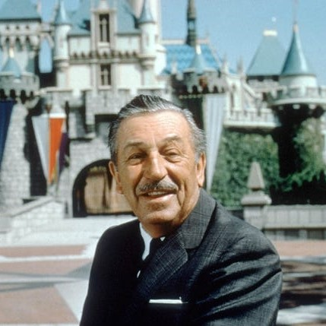
The way to get started is to quit talking and begin doing.
Walt Disney

Slide 11
Start-up Timeline: 8 Months < ∞
Start-up
May, June, Fund Launch,
Company Registrations
Project Development
Momentum
June, July, August
Govt. & Private Partnerships
Prototype, Launch, Feedback
Cascade
September
Series A Funding
Growth, Growth, Growth
Intermission
Next Gen
November, December
Celebrate 1st 100 Queens
Refine Plan for 2nd 100 in 2022
October
Work Smart Ecosystem
Diversify, Evolve, Assist Others

Slide 12
Long View Timeline: 5 years
Start-up
2021, 1st 100 Queens.
Long Term Civilisation Plan
Initial Project Development
Momentum
2022, 2nd 100 Queens
Community Development
Queens Wharf Project Evolution
Cascade
2023, 3rd 100 Queens
Cinematic Universe Deployment
Moonshot, Mars and Asteroids
Intermission
Crescendo
500 Queens & Live Aid 2025
Artistic World Referendum?
Solar Maximum 25 Peak?
2024, 4th 100 Queens
Mergers, Acquisitions & Exits
Solar Maximum 25 Ramp Up

Slide 13

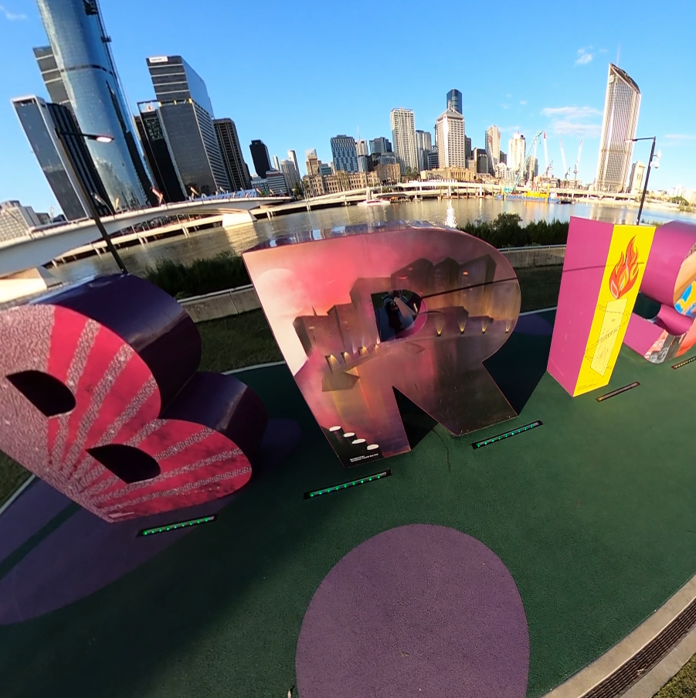
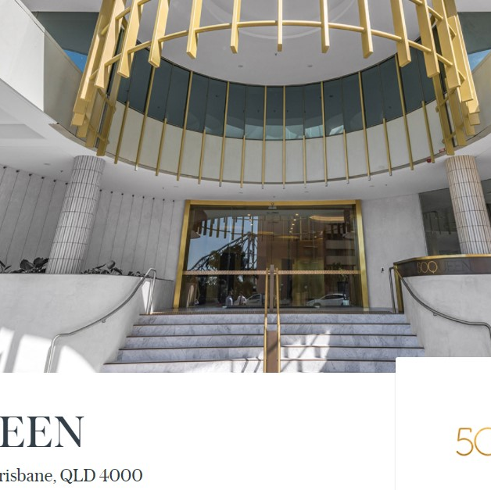

500 Queen St. HQ and Many Venues to Showcase Brisbane’s Spirit to the World.
Assisted Company Registration
Sponsored Weekly Meetups
Just-In-Time Content Delivery
Sponsored In-Kind Services
Local Legends Introductions
Global Legends Virtual Meetings
St.

Slide 14

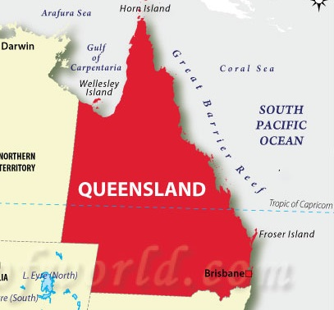
Believe It,
Become It.
Are You In?
I dare to believe this will become the most successful start-up ecosystem in the history of modern human civilisation as all participants master honest communication and the principal virtues of hope, empathy and joyful responsible abundance.

Slide 15



Thank You
Luke Catalyst Nathan Hayes
webmaster@iSeeinfinity.com
https://500QueensVC.com

